Slide 1
WOODDALE HIGH SCHOOL
Thanks for joining us today.
We will begin shortly.
Annual Fall Title I
Parent Meeting
Tuesday, September 23, 2022
9:00 aM & 6:00 PM
https://bit.ly/3xWwEJK
Notes:
good afternoon/morning and thank you parents, guardians, and families for joining us for our annual Fall Title 1 meeting. Let’s get started.

Slide 2
Agenda
Welcome Message from Latonja Robinson, Principal
Title I Overview –Deanna Dye, Title I Coordinator
Policies for Family Engagement
Reporting Pupil Progress
Parent – Teacher Conferences
Parental Involvement Requirements
Availability of Parent Training
School Status
School Improvement Plan
Opportunities for Additional Parent Meetings
Teacher Qualifications
Parents’ Right to Know
Notice of Title I School Status
School / Parent Compact Overview
School/ Parent Compact Suggestions
Student Code of Conduct
Community Partnerships
Notes:
Here is a look at our agenda for today. We will begin with our welcome, a message Vice Principal Tara Brownlee and then we will look at the Title One overview by myself Ms. Dye, Title One Coordinator. During the Title One overview, we will look at the topics listed on the agenda.

Slide 3
Policies for Family Engagement

Slide 4
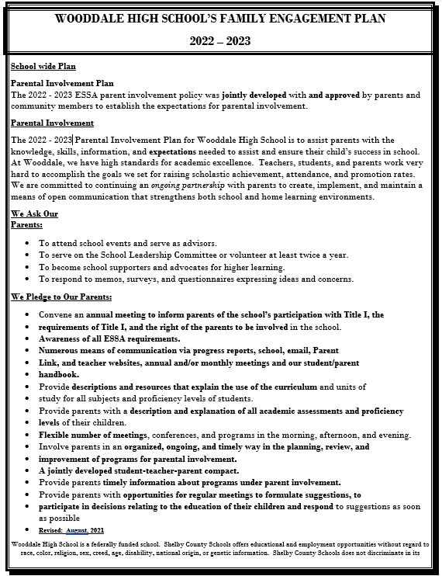
Family Engagement Plan
Notes:
The family engagement plan list requirements in the 2015 ESA which is the every student succeeds act and the components of their plan consists of how parents should be involved in the decision making process and activities happening at the school level they should also be involved in how parental funds are spent with parents trainings and workshops and we need to make sure that parents have access to information in training as well the school works on building the capacity of parents and staff to ensure a strong parental involvement.
Addresses how schools will implement parental involvement requirements of the Every Student Succeeds Act of 2015.
Components include…
How parents can be involved in decision-making and activities
How parental involvement funds are being used
How information and training will be provided to parents
How the school will build capacity in parents and staff for strong parental involvement

Slide 5
We Ask Our Parents:
To attend school events and serve as advisors.
To serve on the School Leadership Committee or volunteer at least twice a year.
To become school supporters and advocates for higher learning.
To respond to memos, surveys, and questionnaires expressing ideas and concerns.
Notes:
On the window high school family engagement plan we ask our parents to attend school events and activities serve on the school leadership or volunteer at least twice a year to become supporters and advocates for higher learning for our students and to respond to memo surveys and concerns.

Slide 6
Reporting Pupil Progress

Slide 7
Assessing and Monitoring Progress
Students enrolled in an End of Course class (English I, English II, Algebra I, Algebra 2, Geometry or Biology) will take quarterly District common formative assessments through Mastery Connect, as well as in-house bi-weekly assessments. Data from the assessments will be used to monitor students progress towards their goals of being proficient on the End of Course Exams.
Notes:
When we talk about reporting pupil progress ways that we are currently assisting and monitoring student progress as through quarterly assessments by the district through a platform called mastery connect as well as benchmark and interim assessments by the izzone which we take through a net.

Slide 8
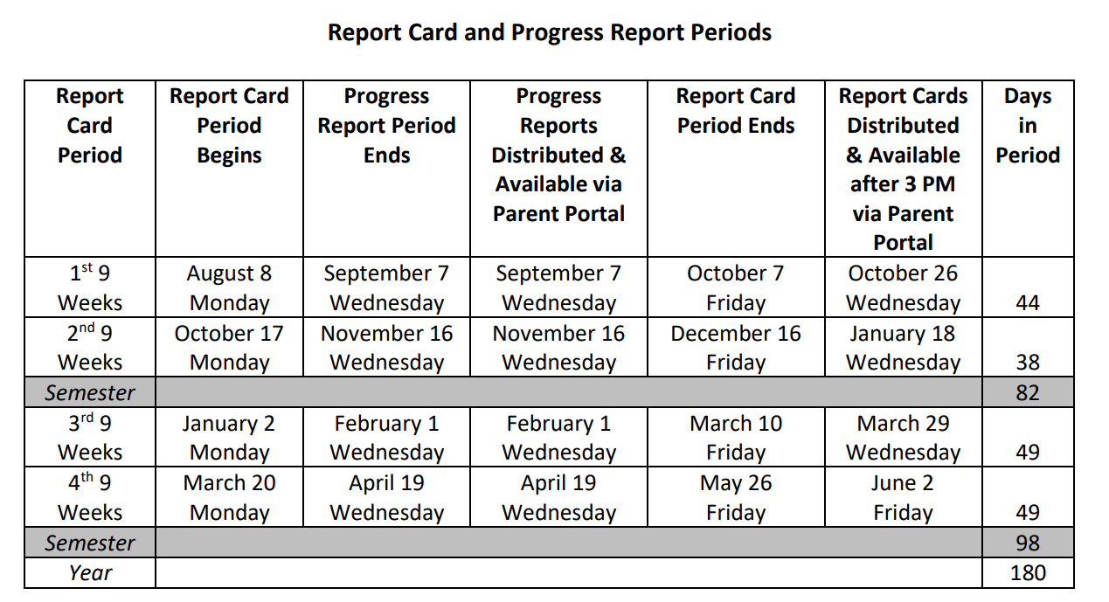
Reporting Progress

Slide 9
Parent – Teacher Conferences

Slide 10
Scheduling A Conference with your child’s teacher
Parent Teacher Conferences
September 8th (4 pm – 7 pm
February 16th (4 pm – 7 pm)
Book an appointment.
Send your child’s teacher an email requesting a parent teacher conference.

Slide 11
Parental Involvement Requirements

Slide 12
Parental Involvement
Parental Involvement Opportunities at Wooddale High:
Utilizing your talents and/or resources to enhance the instructional programs at Wooddale High
Serving on the WHS School Improvement Plan
Responding to questionnaires, surveys, and memos expressing thoughts, suggestions, and/or concerns.
Attending school events such as Parent Nights and Parent Conferences
Engaging with teachers through calls and emails
Frequently checking on your child’s grades and conduct

Slide 13
Parental Rights
All parents have the right to request the following:
A teacher’s professional qualifications, which includes: state qualifications, licensure, grade(s) certification, waivers
A teacher’s baccalaureate and /or graduate degree, fields of endorsement, previous teaching experience
A paraprofessional’s qualifications
An assurance that their child’s name, address, and telephone listing will not be released to military recruiters

Slide 14
Parental Rights
All parents will receive information on the following:
Their child’s level of achievement in each of the state academic assessments
Their option to request a transfer to another school within the district if their child is the victim of a violent crime at school
Their right to timely notification that their child has been assigned, or has been taught for four or more consecutive weeks by, a teacher who is not highly qualified

Slide 15
Availability of Parent Training And Opportunities for additional Parent Meetings

Slide 16
Month | Date(s) | Event | Location | Time
September | 9th | Parent-Teacher Conferences | In-Person @ WHS | 4:00pm -7:00pm
October | TBD | Fasfa Workshop | In Person @ WHS | TBD
November | TBD | RTI Parent Workshop | Virtual (Microsoft Teams) | 4:30pm – 5:30pm

Slide 17
School Status

Slide 18
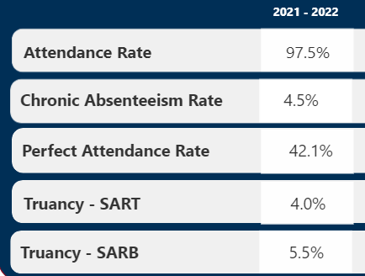
The State of Wooddale
Based on prior testing data, Wooddale High School is classified as a Priority School.
Priority Schools are the lowest-performing 5% of schools in Tennessee in terms of academic achievement.
Priority school designations are from the previous 3 years of testing data.
Source: Power BI

Slide 19
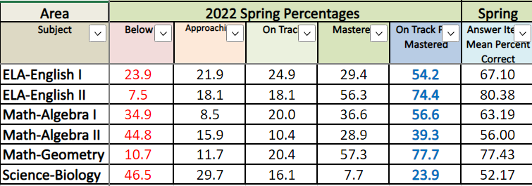
The State of Wooddale
2021-22
General District Assessment
Data and EOC Scores

Slide 20
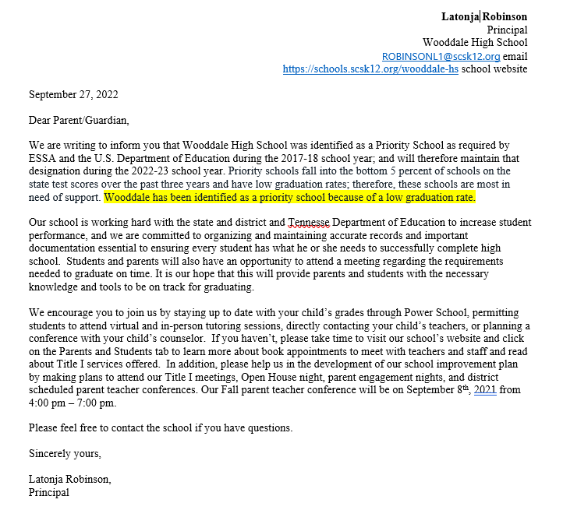
Wooddale High School is a State Priority School.

Slide 21
School Improvement Plan

Slide 22
Critical needs areas and focus
Goal #1 - Reading/Language Arts
English 1 and English II
Goal #2 - Mathematics
Algebra 1, Algebra 2, Geometry
Goal #3 - College and Career Readiness
ACT Preparation
Post Secondary Opportunities
Career Exploration and Work-Based Learning Opportunities
Effective Transitions
Goal #4 – Climate and Access
A 4.3.1 Professional Development - Parents
Provide workshops, supplies, materials, and other training opportunities using a variety of delivery systems to support parents in understanding the importance of daily school attendance, as well as the opportunities available for high school graduates.
Student Attendance & Suspension Rates
Notes:
There are four critical needs and focus areas around our school improvement plan our first goal and focus area is English and language arts which includes the English one English 2 classes our second goal is mathematics and our third goal is college and career readiness these are the goals in which we spend or focus our school improvement plan around the fourth goal is about safe and healthy students and that go one of our action steps is to increase the professional development and activities offered for parents at school so if you need additional support surround virtual school learning additional supports around teams training additional supports around trends that you're seeing happening in our schools and communities in what ways can we as with their high school support our parents and students and what resources can we look into providing for you parents and students so you will see that we have in our school improvement plan to operate an action plan to increase our professional development

Slide 23
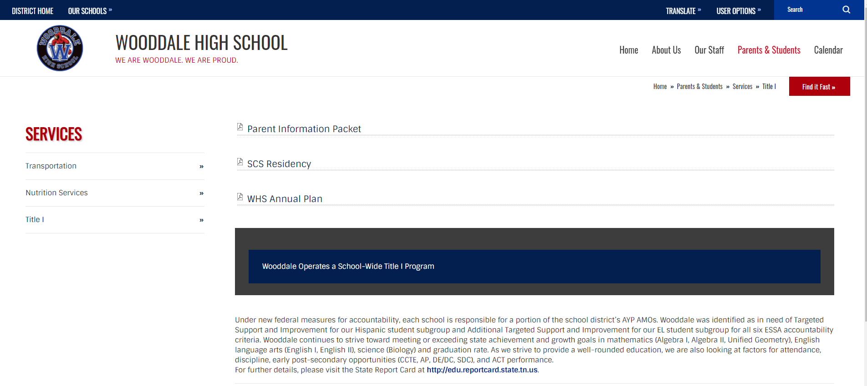
School Improvement Plan
Notes:
For more information on our school improvement plan you can visit the Wooddale high schools website click on services and you'll see on the title the title one page the parent information package which cool includes our parent involvement an apparent involvement plan and parents rights to know along with other documents and then you will also see the WHS annual plan which is our school improvement plan the plan that you will see now is our 2019-2020 school plan as we are still in the planning phase for the current 2020-2021 school year.

Slide 24
Teacher Qualifications

Slide 25
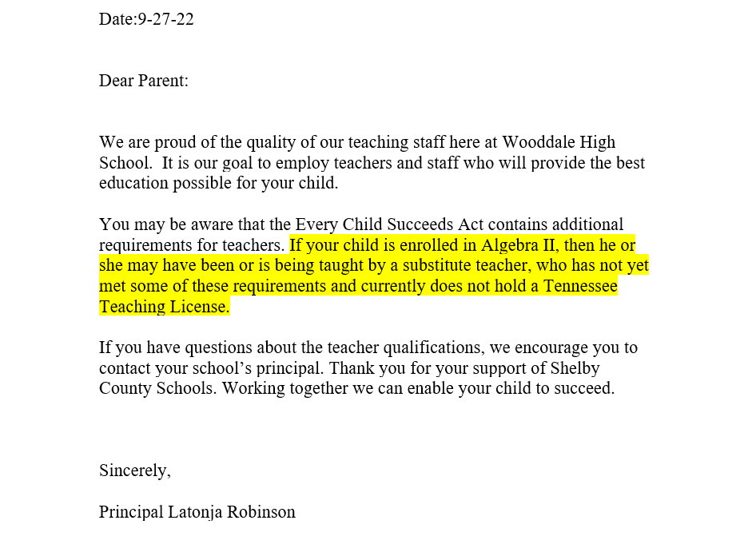
The 7%

Slide 26
Parents’ Right to Know

Slide 27
Parents’ Right to Know
All parents have the right to request the following:
A teacher’s professional qualification, which includes state qualifications, licensure, grades certification, waivers
A teacher’s baccalaureate and/or graduate degree, fields of endorsement, previous teaching experience
A paraprofessional’s qualifications
An assurance that their child’s name, address and telephone listing may not be released to military recruiters
All parents will receive information on the following:
Their child’s level of achievement in each of the state academic assessments
Their option to request a transformer to another school within the district if their child is the victim of a violent crime at school
Their right to timely notification that their child has been assigned, or has been taught or four or more consecutive weeks by, a teacher who is not highly qualified
For additional information visit the TN Department of Education at http://www.state.tn.us/educatioin/reportcard/index.shtml

Slide 28
Notice of Title I School Status

Slide 29
What does it mean to be a Title 1 School?
Being a Title I school means receiving federal funding (Title I dollars) to supplement the school’s existing programs. These dollars are used for…
Identifying students experiencing academic difficulties and providing timely assistance to help these students meet the State’s challenging content standards.
Purchasing supplemental staff/programs/materials/supplies
Conducting parental Involvement meetings/trainings/activities
Recruiting/Hiring/Retaining Highly Qualified Teachers
Being a Title I school also means parental involvement and parents’ rights.

Slide 30
Goals of Title I
Increase academic achievement
Provide direct instructional support to students.
Provide professional development for teachers.
Promote parent education and involvement.

Slide 31
School / Parent Compact

Slide 32
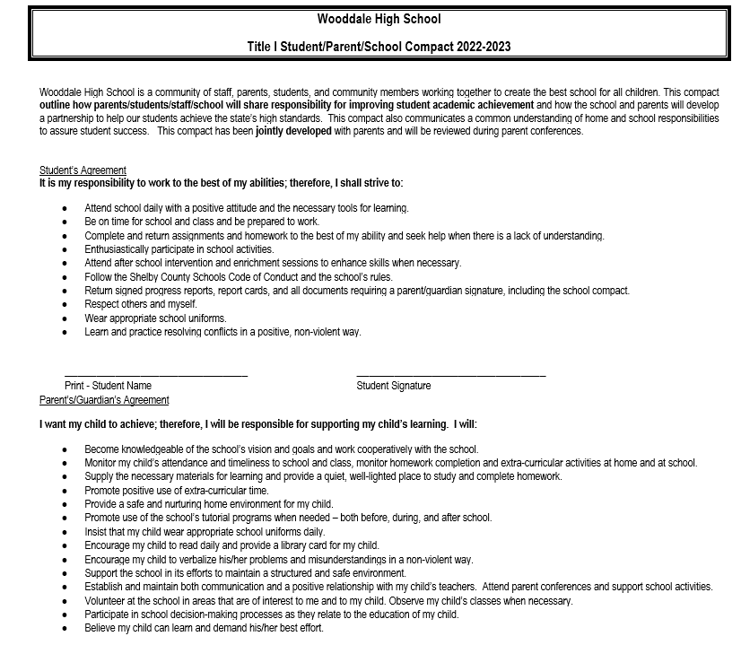
School / Parent Compact
The compact is a commitment from the school, parent, and student to share in the responsibility for improved academic achievement.
Title I Parents have the right to be involved in the development of the School-Parent Compact.

Slide 33
School / Parent Compact
Suggestions Please!

Slide 34
Student code of Conduct

Slide 35
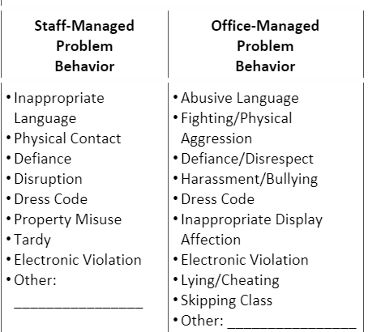

Slide 36
Community Partners

Slide 37
AgAPE Child Family Services

Slide 38
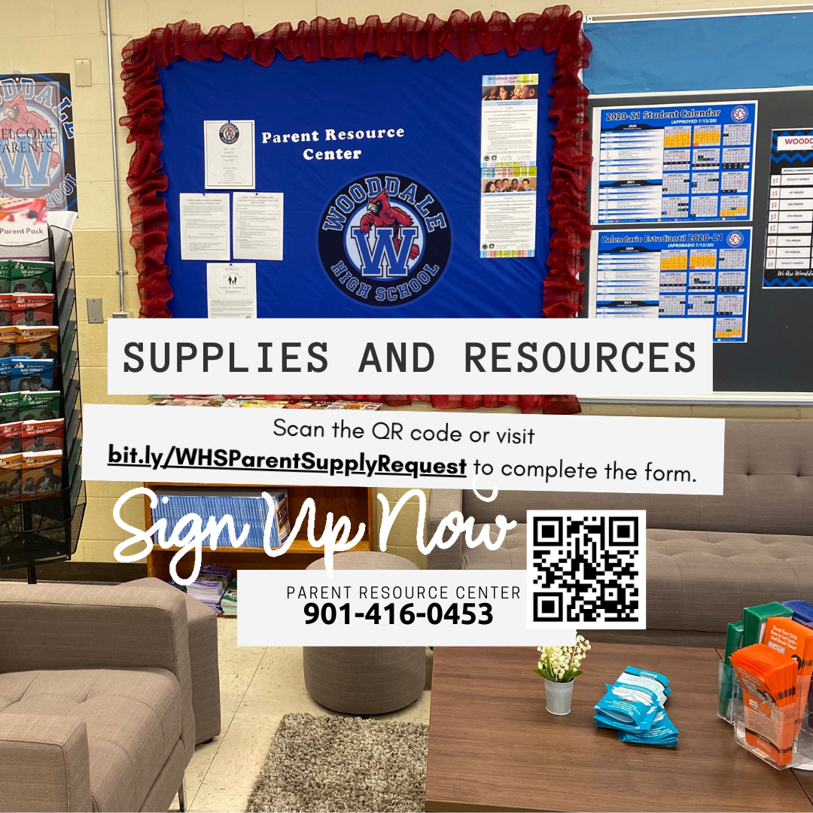
Questions
Visit the school website for access to Title I documents.
https://schools.scsk12.org/wooddale-hs
Follow Us on Social Media

